Slide 1
Homework 2
Computer Vision 2024 Spring
2024.4.25

Slide 2
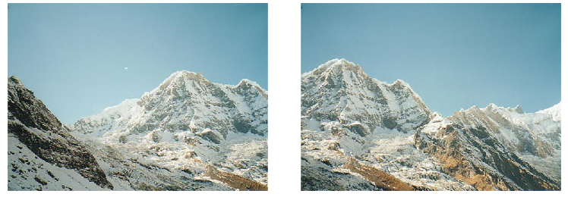
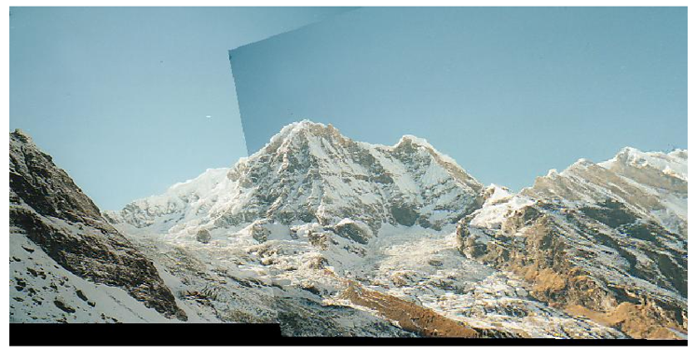
Image stitching
Detecting key point(feature) on the images
SIFT
Finding features correspondences (feature matching)
KNN
Computing homography matrix.
RANSAC
Stitching image (warp images into same coordinate system)
Homography
Notes:
The goal of this HW is to stitch multiple sequential image together by SIFT.
Here is the pseudo code of image stitching.
First we need to detect key points of two images by SIFT and then use KNN to match the key points to find the similarity between two images.
Third we can use RANSAC to find a best homography matrix to transform the perspective of one image to another image.
Finally we can stitch them together in same coordinate system.

Slide 3
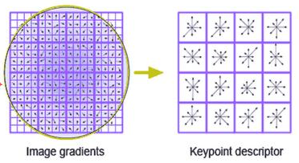
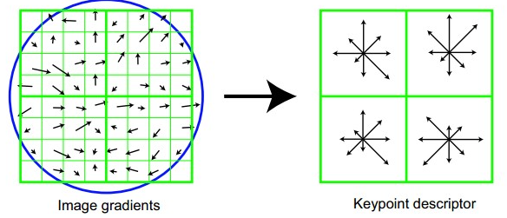
Feature Detection
Finding features correspondences/compute homography matrix.
SIFT – Scale Invariant Feature Detection
detect key points in the image and describe the points as 128-dimensional features (4 * 4 * 8).
Check Ch.6、7 for more details of SIFT.
Notes:
SIFT can detect the key point on image and for every single key point, it has a 128 dimensional discirptor. For one descriptor , It looks like the picture on left, one discriptor has 4 by 4 blocks. And every one block in discriptor would use 4 by 4 pixel to calculate the gradient and stores those gradient as a 8 bins histogram. So a descriptor is a 4 times 4 blocks times 8 bins totally 128 dimensional feature. And because it is invariants to scale and rotation , It is useful to help us to find the similarity between two image.

Slide 4
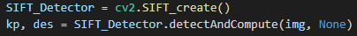
1. SIFT in OpenCV
Using OpenCV to detect SIFT key points of two images
Input : gray scale image
output : keypoints (array), Descriptors (array)
Keypoints store feature points
for a single keypoint you can use “.pt” to get the position of this key point on image [Ref]
Descriptors store the 128-dimensional features
The function name(detectAndCompute) of SIFT may be different with the version of OpenCV
Notes:
The first step of HW2 you need to detect the key point on two image by SIFT.
For SIFT you can directly use the function provided by OpenCV to get the key point and their descriptor. Because SIFT works on gray scale image, you need to convert the image to grayscale first.
The output of this function is a array storing all the key point and another array storing the descriptor..
For the element of key point array, It’s a OpenCV defined class you can use “.pt”” to get the position of key point on image. And descriptor array storing the 128-dimensional features of every key point. more detail about key point class please check the OpenCV document.
And there may have different function name in different version . You may need to google it.

Slide 5
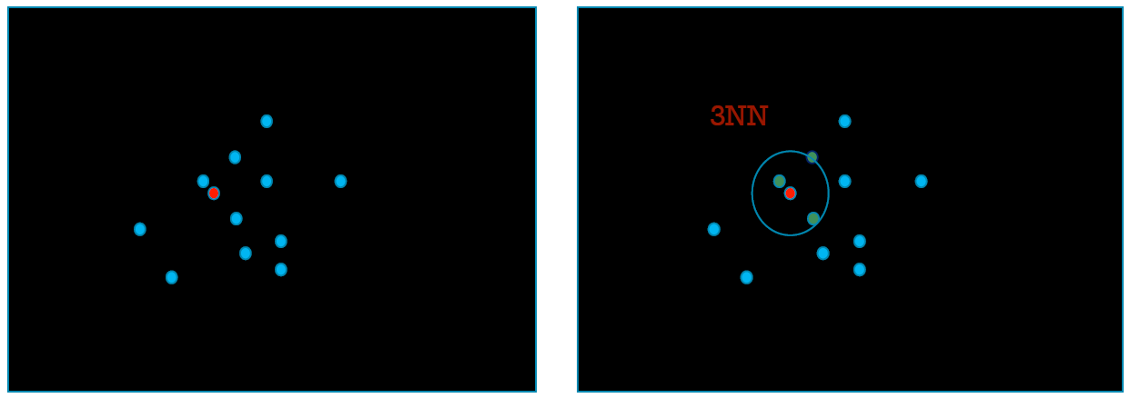
2. Feature matching - KNN
K-Nearest Neighbor
Finding the K closest neighbors to the target.
Brute-force : Comparing with the all 2-norm of SIFT feature (the 2-norm of descriptor)
Notes:
Second step after SIFT we will get two bunches of key points. We need to match them one by one. and make sure about that the match is a good match which means it doesn’t match to a noise key point.
So we need the concept of KNN (k-neares neighbor). For every key point on image1 we will find the K closest key point on image2. We can use the brute-force way to achieve it. For one keypoint on image1, just comparing with the 2-norm of every key points on image2 to find the closest K match.

Slide 6
2. Feature matching - Lowe’s Ratio test
Lowe’s Ratio test for eliminating bad match
A good match shold be able to be distinguished from noise
1. For every key point P in image1 using 2NN to get 2 matched key points P1 & P2 in image2
2. Computing the 2-norm of P1 & P2 between P named D1 , D2
3. If D1 < threshold * D2 then P1 is a good match
(threshold is a programmer defined ration between 0 to 1 , the suggestion of OpenCV tutorial is 0.7~0.8)
P1 (good match)
D1
P
D2
P2 (noise)
Notes:
To determine whether a match is a good match , we can use the Lowe’s ration test. This test need two match for every key point and assume that the match with the smallest distance is a "good" match, and another one is random noise. If the “good” match can't be distinguished from noise, then this match should be rejected.
Here is the pseudo code. First using 2-NN to find two cloest match.
Then comparing with their 2-norm. the threshold here is a programmer defined parameter. If the match doesn’t satisfy this condition meaning its close to noise. So we can eliminate it directly.

Slide 7
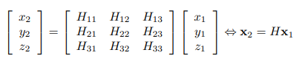
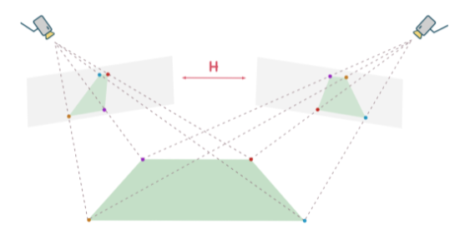
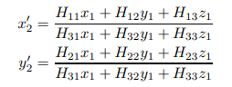
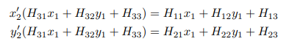
3.Homography
Construct a linear system as: P2=HP1, P2 = (x2,y2,1) , P1 = (x1,y1,1) where P2 and P1 are correspondence points , H is homography matrix.
Notes:
Now we have the match of key point and we can know the correspondence between two images, then we need to transform the perspective of one image to another one’s perspective to stitch they together.
We can use homography to achieve this work, so we need to find the homography matrix first. It’s a 3 by 3 matrix with 8 degree of freedom. Because homography works in homogeneous coordinates, the point here is represented as (x , y , 1) with one more axis. Below is the deduction, you can use homography matrix to transform one point to another perspective coordinate , if you expand the equation and divide the third coordinate because of the point in homogenous coordinate the third axis must equal to 1. And then you can get two equation.

Slide 8
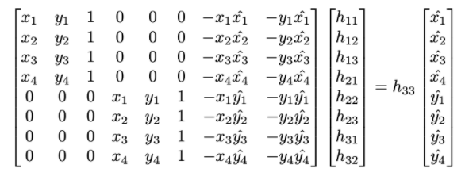
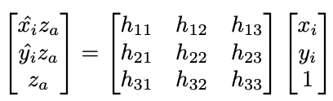
3.Homography
If we restrict h33 = 1
For perspective transformation , you can use 4 pairs of match result to solve 8 unknown variable in homography matrix
Notes:
And then if we restrict the last element h33 to 1. We can find the unique solution of homography matrix and we only need 4 matches to find it.

Slide 9
3.Homography
Let h33 = 1
You can solve the equation Ah = b below by pseudo inverse
A
h
b
H

Slide 10
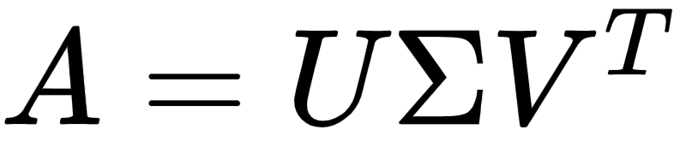



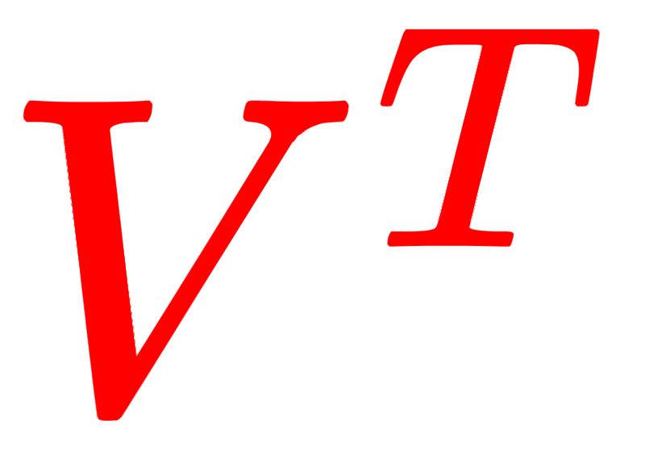
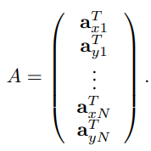
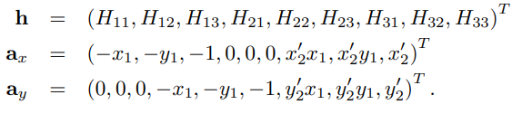
3.Homography
Using SVD decomposition to find Least Squares error solution of Ah = 0
the solution = eigenvector of associated with the smallest eigenvalue (V stores the eigenvector of , stores the singular value (root of eigen value)) find the smallest number in and H = corresponding vector in
Remember to normalize h33 to 1
You can multiply a minus to match the form in previous slide
A is a 9 by 9 matrix (It’s similar to A in previous slide)
Reference : SVD : https://web.mit.edu/be.400/www/SVD/Singular_Value_Decomposition.htm Homography : https://cseweb.ucsd.edu/classes/wi07/cse252a/homography_estimation/homography_estimation.pdf
Notes:
For this part you need to construct this A matrix first . And then you can use SVD decomposition to find the least squares error solution of Homography matrix H.
In conclusion the solution is the eigenvector of ATA associated with the smallest eigenvalue. In SVD decomposition the V matrix stores the eigenvector of ATA, the sigma matrix storing the singular value equal to the root of eigen value . So we just need find the smallest number in sigma matrix & the corresponding vector in V transpose is the solution of Homography matrix.(and usually the singular value is sorted from big to small so the answer is the last one)
Remember to normalize h33 to 1 after find the Homography matrix

Slide 11
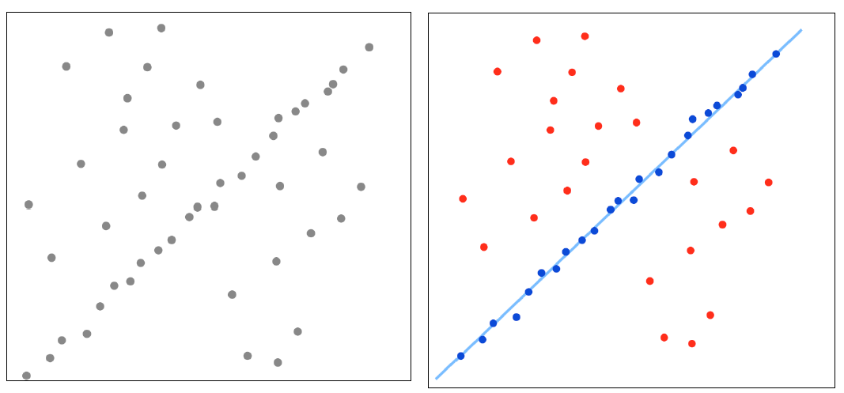
3.RANSAC
Random Sample Consensus
Input : 𝑀 match;
Randomly select 4 data points as inliers 𝑆.Find a homography matrix H to 𝑆.
Test all match(p1 , p2) against H, estimate p2’ = p1 * H - if the distance between p2’ and p2 is small , add the match to 𝑆, which is called a consensus set.
If |𝑆| is larger than ever, mark H as the best estimated H∗.
If some stopping criterion is satisfied, end
Else go to step 1.
Note that you can re-estimate the models with the consensus sets.
Notes:
We know how to find Homography matrix and we only need four matches of keypoint but now we have a lot of matched key point. How do we find the best one? We need RANSAC to find the best homography matrix from those matches. Taking the picture on top right side for example, we want to find a line to fit those gray point but least square method may not work in this situation because of a lot of outlier. So the concept of RANSAC is roughly trying all the possibility. RANSAC may randomly pick the point to build a line and estimate the total error of this line. After certain iteration RANSAC can find a line have high probability closing to the answer .
Here we can randomly pick 4 matches of keypoint to compute a homography matrix and calculate the error of every keypoint to judge whether it’s the best homography matrx. you need to keep trying these step after certain iteration. In the end you can get a matrix H with small error for every keypoint

Slide 12
4. Stitching image
1. Using homography matrix H to calculate the position of 4 corners of image1 in the perspective of image2
2. Using image1 after perspective transformation to analyze the size which we need to combine two image together of
3. Using cv2.warpPerspective(src, M, dsize, ...) to warp the whole image1
src is source image1 , M is homography matrix H , dsize is output image size
4. Concating two images (for better results you can use blending or some ways to improve the quality of overlap part)
For stitching images you can use any function of OpenCV
Notes:
Finally we can use the homography matrix to stitch two image together. For stitching image you can use any function provided by OpenCV but for other part has some limitation I will mention late on. Here I will introduce a way to stich image and below is the pseudo code

Slide 13
4. Stitching image - more detail
corners’ = corners * H
x1’ = min(min(corners’_x),0)
y1’ = min(min(corners’_y),0)
Assume image1 is on left hand side and image2 is on right hand side
Size we need = (w2 + abs(x1’) , h2 + abs(y1’))
width of image2 = w2
height of image2 = h2
H (homography)
O (0 , 0)
C1 (x1,y1)
C1’ (x1’,y1’)
Notes:
Assume image1 is on left hand side and image2 is on right hand side. Because we will work in the perspective of image2 so assume the left-bottom corner of image2 is origin. First using homography matrix to transform the position of 4 corners of image1 to the perspective of image2 and then we can compare them to know the size we need for stitching image. In this case for example, image1 is on left bottom so the size we need is image2 width & height + absolute minmum corner

Slide 14
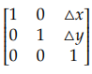
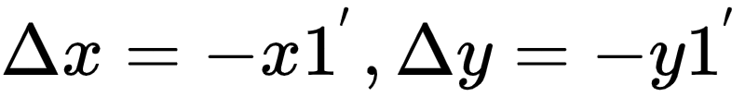
4. Stitching image - more detail
For both images using affine translation to move the origin O to C1’. This way gives some space to image1 and it’s easier to combine them in same image size.
For image1 your homograhpy matrix(H)s need multiply translation matrix (A) because we translate the perspective of image2
For image2 you can directly warp with affine translation matrix(A)
A*H
Affine translation matrix (A) =
O (0 , 0)
In this case Because origin moves to down left,
image2 needs move to top right relatively
C1 (x1,y1)
C1’ (x1’,y1’)
Notes:
For moving the space for image1 and easily stitch two image together we can use affine translation to move the origin to C1’ let two image in same size.
In this case the delta in translation matrix is -x1’ and -y1’ because the origin moves to down left, image2 should move to top right relatively.
Here need to be careful that homography matrix need to multiply translation matrix A because we translate the perspective of image2 and image2 can directly use affine translation matrix A

Slide 15
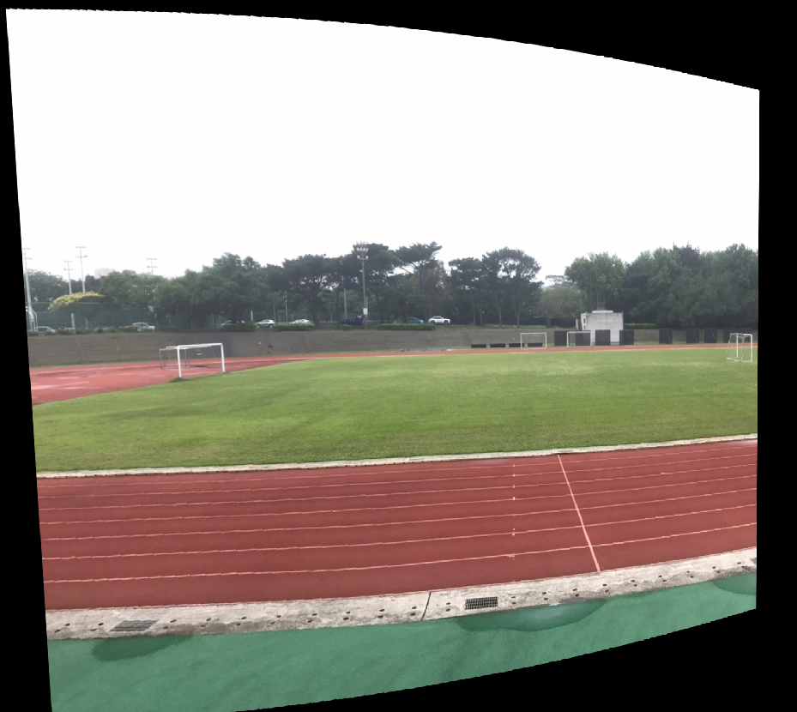
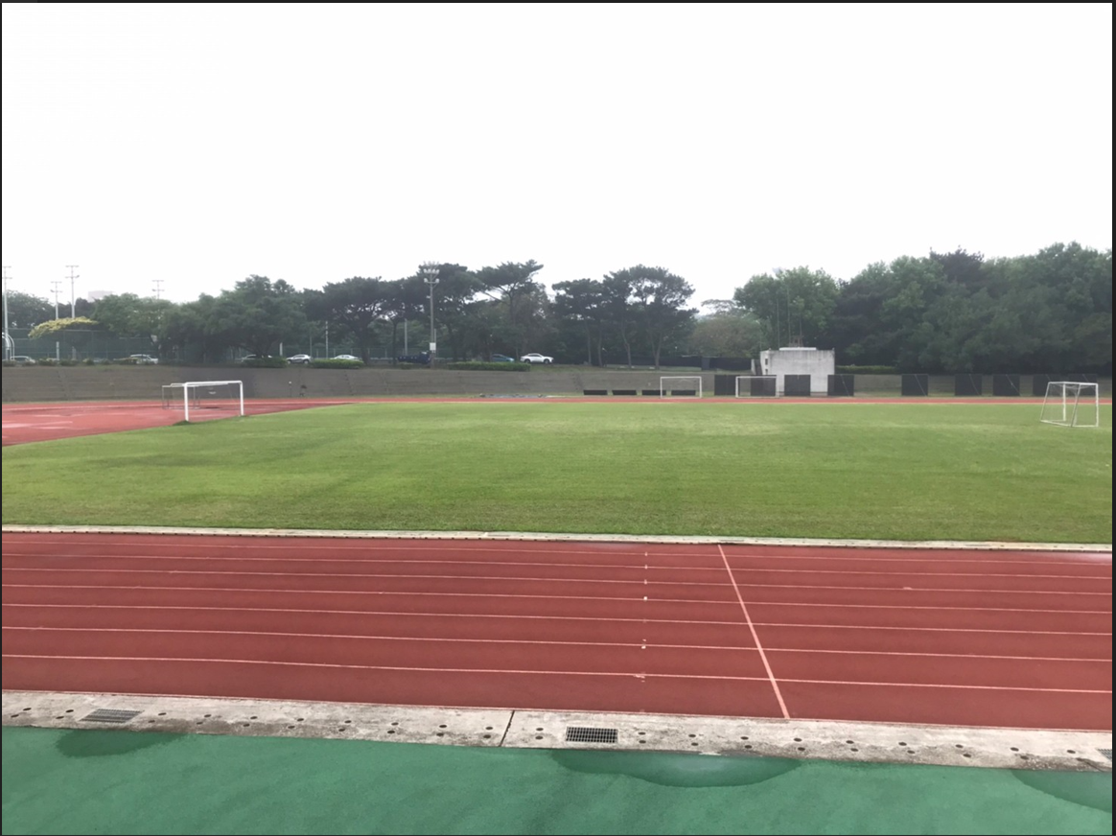
4. Stitching image - more detail
Example for image1 applys perspective transformation
A*H
Notes:
And then we can warp the whole image1 by CV2.warpPerspective

Slide 16
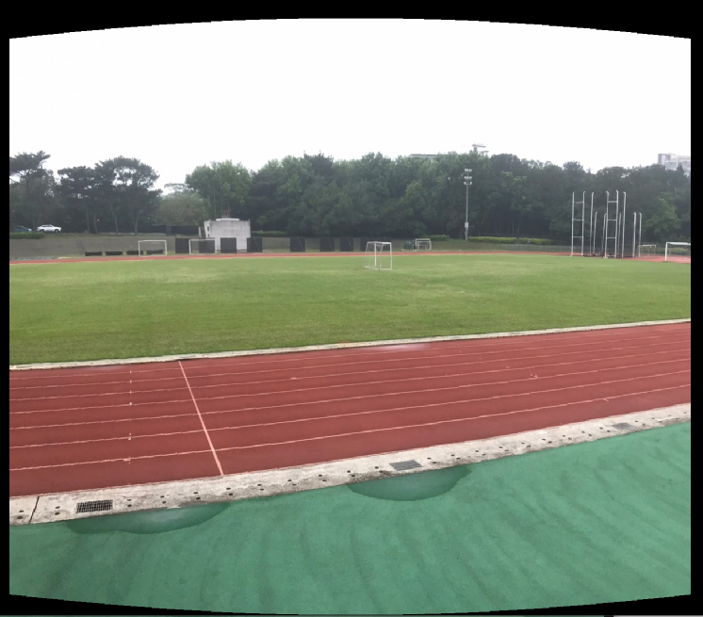
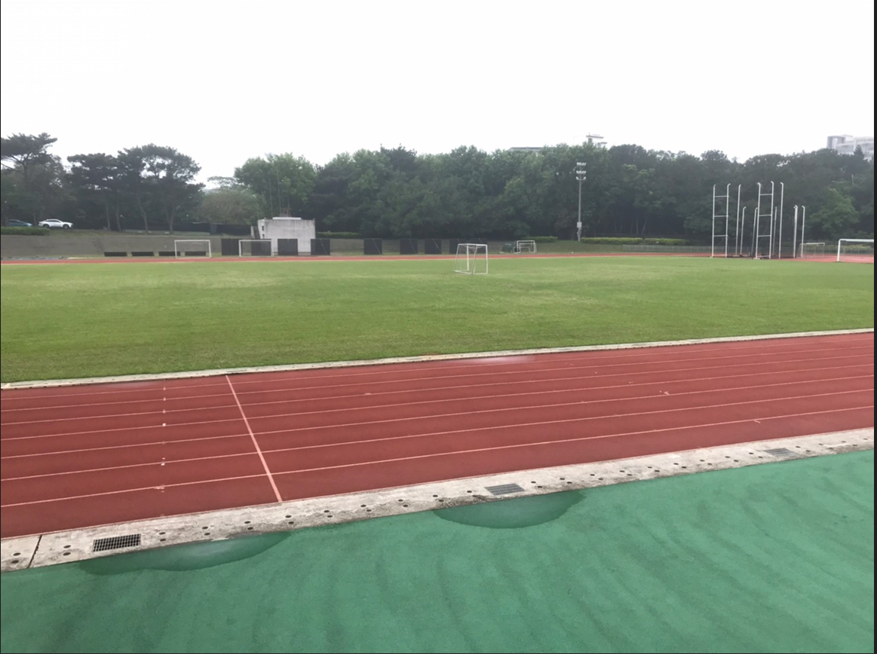
4. Stitching image - more detail
Example for using affine translation to move the image2 origin O to C1’
A
Notes:
And then we can use warpPerspective again to warp the iamge2.
Finally you can compare the pixel of two image one by one and stitch them together.

Slide 17
Requirements
You are only allowed to use the function of OpenCV mentioned in previous slides. Please implement all (key point matching ,RANSAC , Homography , cylindrical projections,...) by youself
For submission you can use :
SIFT
For debugging only:
KNN match : BFMatcher()
Homography : findHomography()
But there is no limitation of “image stitching” only (You can use any function provided by OpenCV)
Notes:
The limitation of this HW. You are only allowed to use the SIFT related function in first three part. If you feel your implementation is too slow you can use those function for debugging only . And for image stitching there is no limitation. You can use any OpenCV function.

Slide 18
Grading
50% Image stitching
SIFT (10%)
KNN (10%)
RANSAC (15%)
Homography (15%)
30% Report (Don’t just paste the code with comment) 1.Explain your implementation 2.Show the result of stitching “Base” images (and “Challenge image” if you did that part). 3.Discuss different blending method result.
(The below two part of grade you got may “vary” according to the stitched image “quality”, methods you used, and so forth.)
10% Stitching 3 images seamlessly with blending and show result in report
10% Challenging task: stitching 6 modified photos with gain compensation method applied, and then showing the result in the report and explaining what you did.
Notes:
Here is the grading policy. The report please explain your implementation and show the result of stiching 2 images , 3 images or more. and compare the result . For example : you can explain what happen when you concate more image together …
Note that the grade you got may vary according to the stitched image quality, methods you used, and so forth.

Slide 19
Deadline
Deadline : 2024/05/12 (Mon.) 11:59 pm
Please zip the all files and name it as {studentID}_HW2.zip : ex 312550000_HW2.zip (wrong file format may get -10% panelty)
Zip file format:
1. {studentID}_report.pdf
2. your code
Penalty of 3% of the value of the assignment per late day
late a day : your_score * 0.97
late two days : your_score * 0.94 ……
Feel free to send e-mails through E3 platform to all TAs for personal questions.
Notes:
The deadline is 5/12

Slide 20
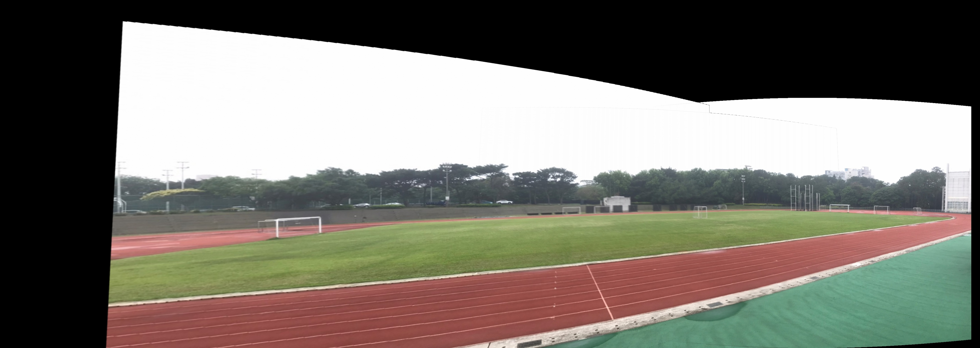
Example Result
Sample of concatenating all 3 Base images

Slide 21
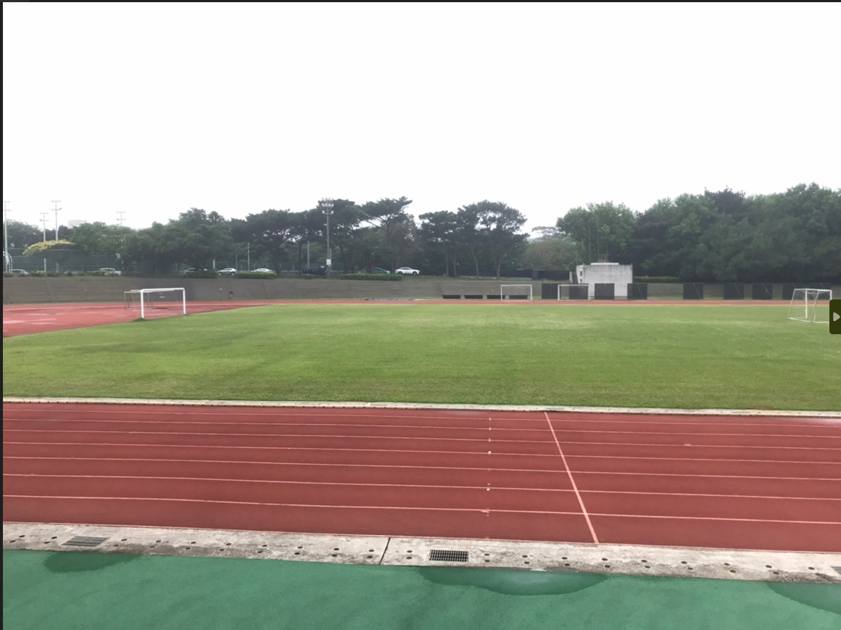
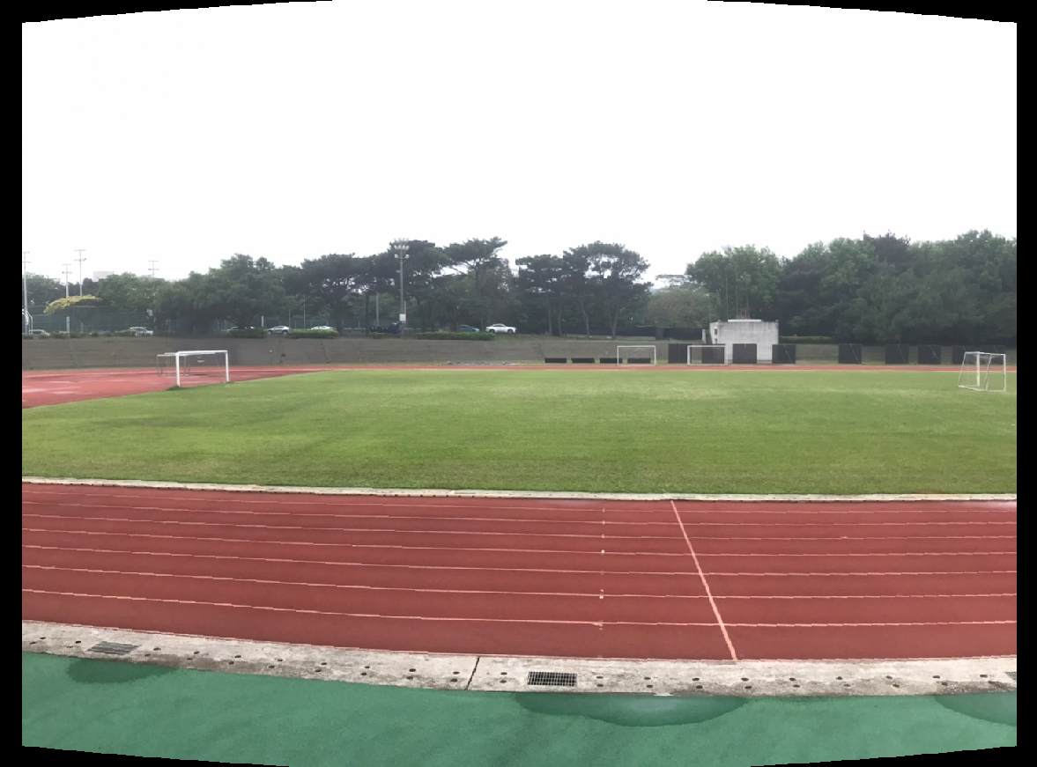
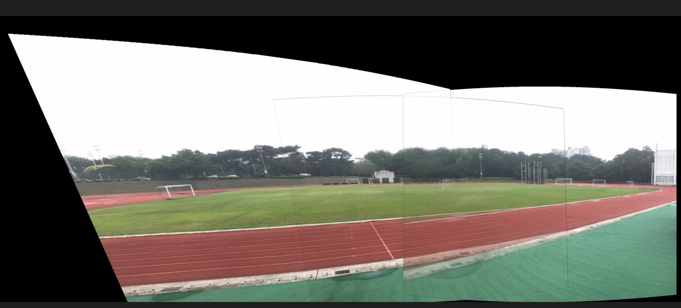
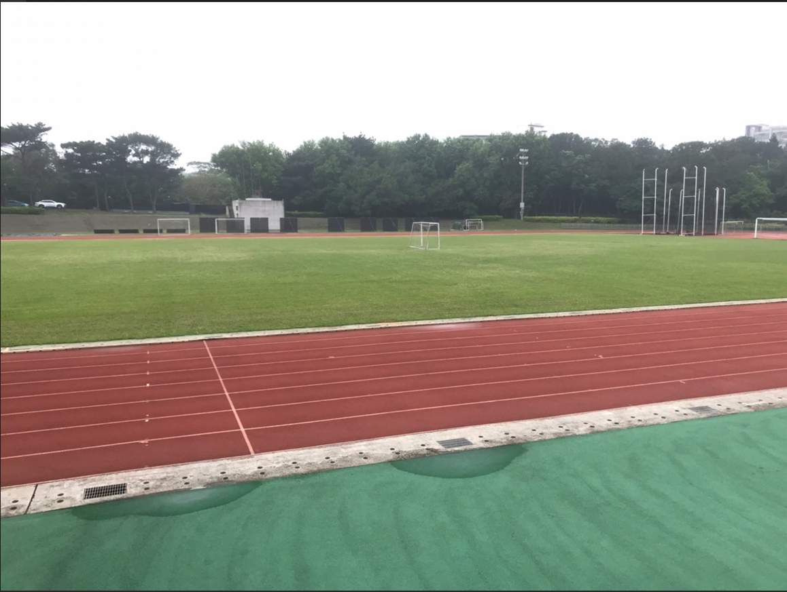
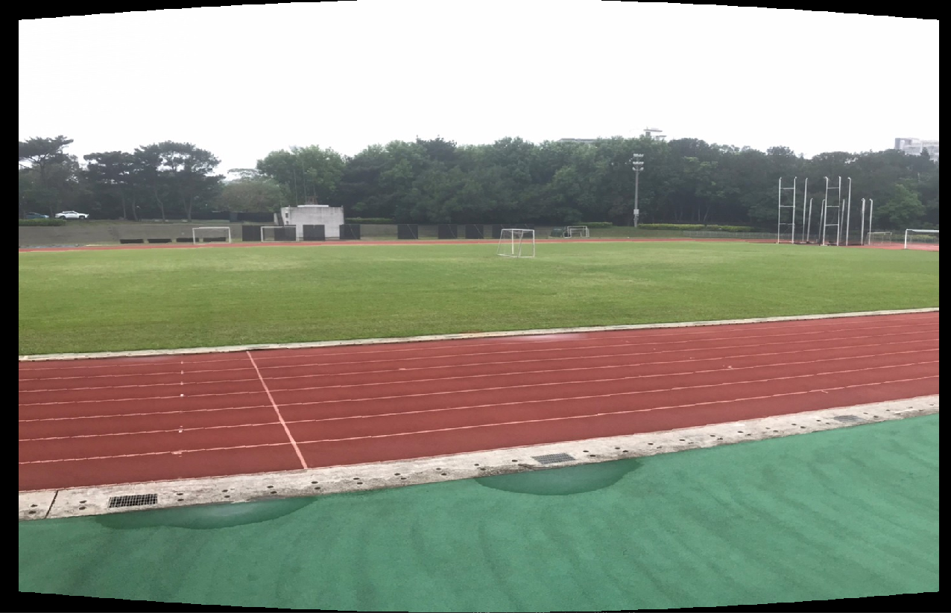
Others Tips
Using different blending method to improve the quality
Preprocessing for more easily concatenate multiple image : Cylindrical projection
Bad blending method example
Cylindrical projection on images

Slide 22
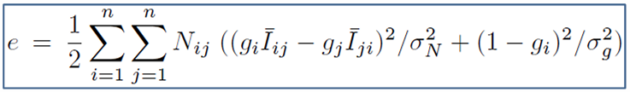
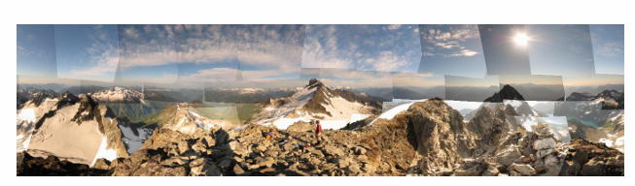
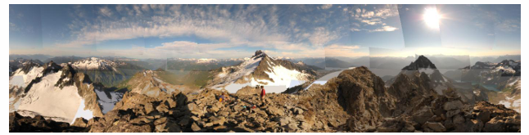
Challenging Task-Gain compensation
Notes:
Explain Gain compensation

Slide 23
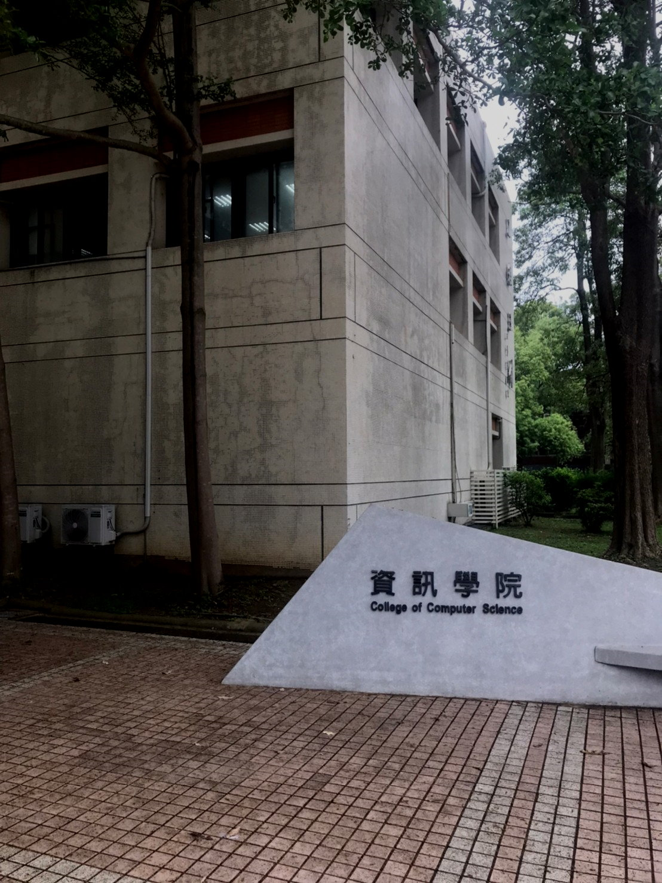
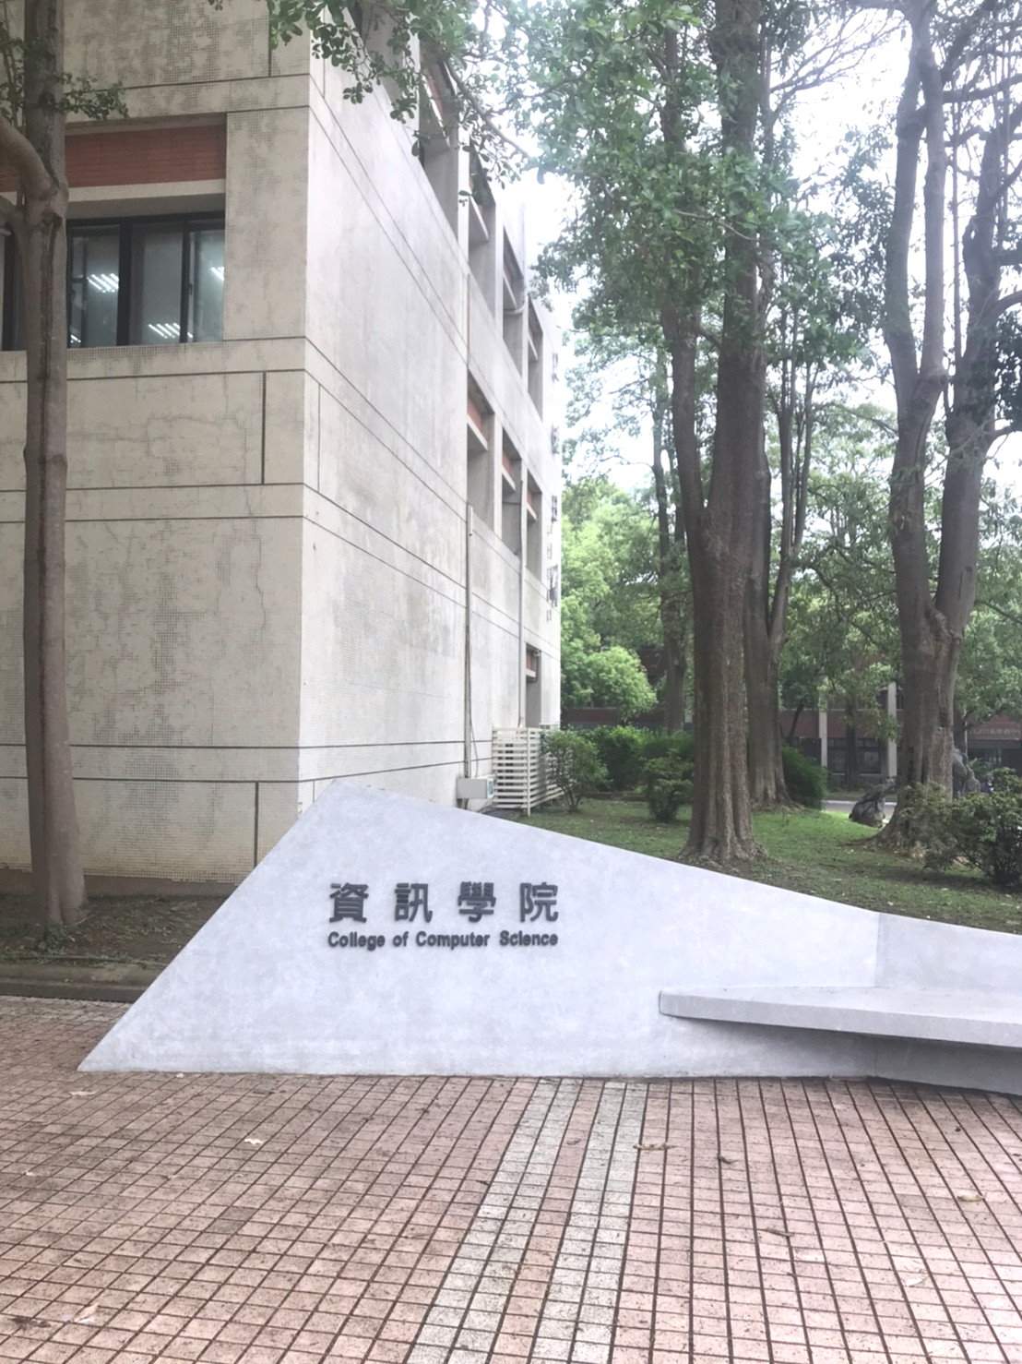
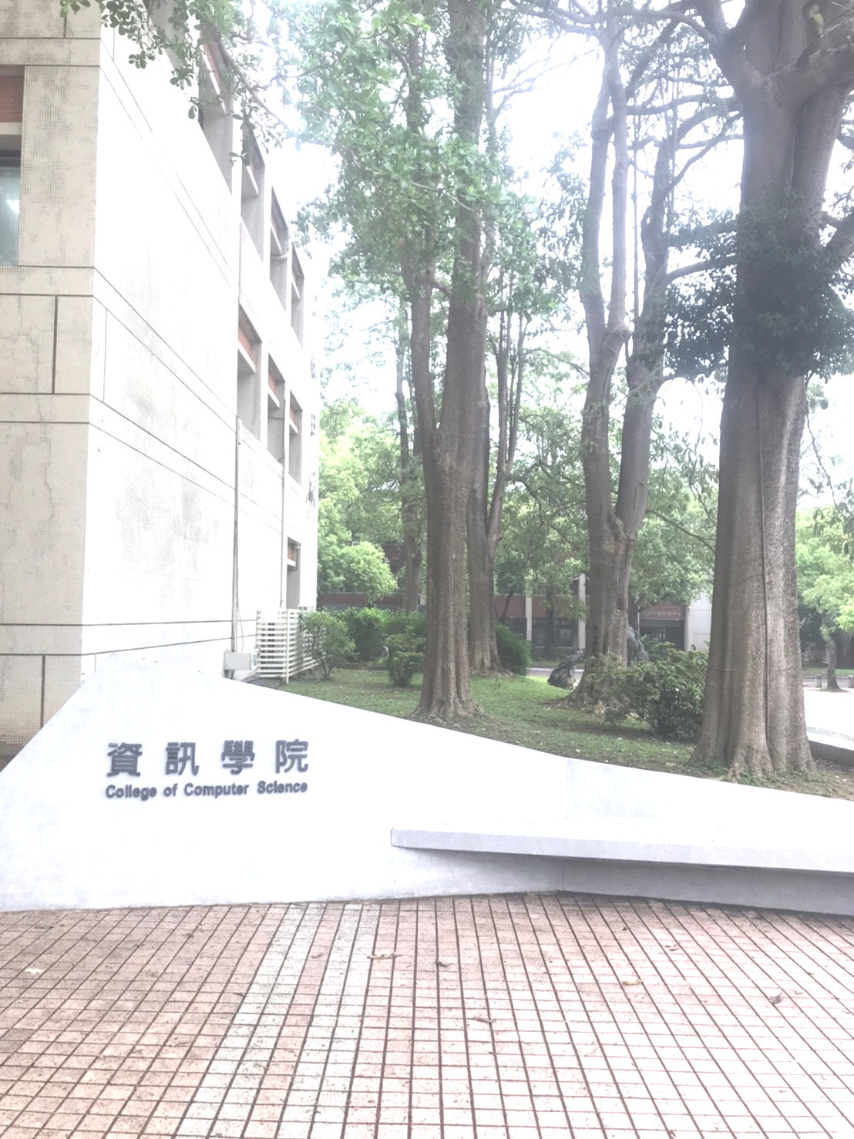
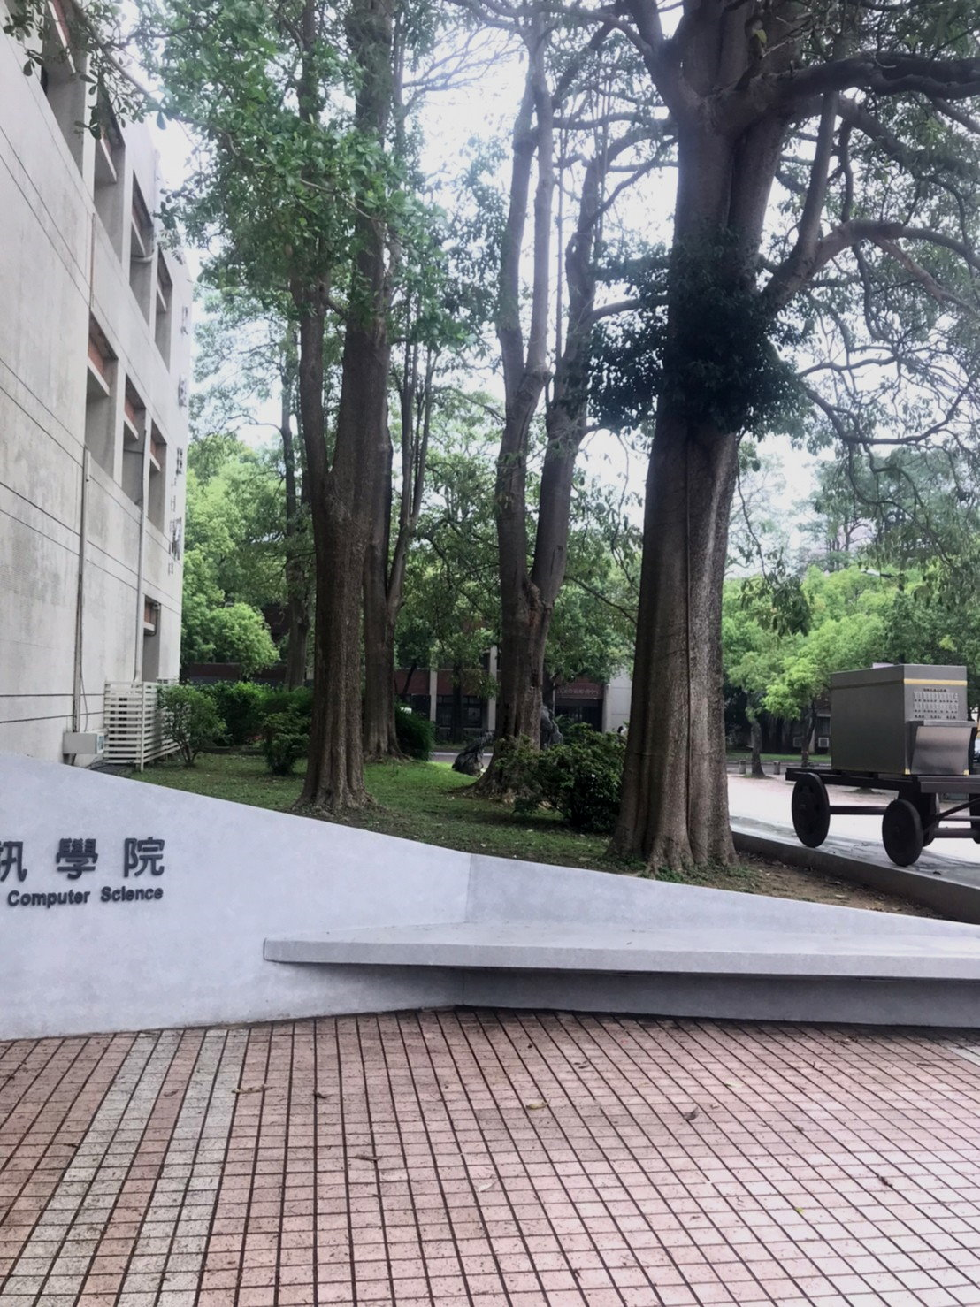
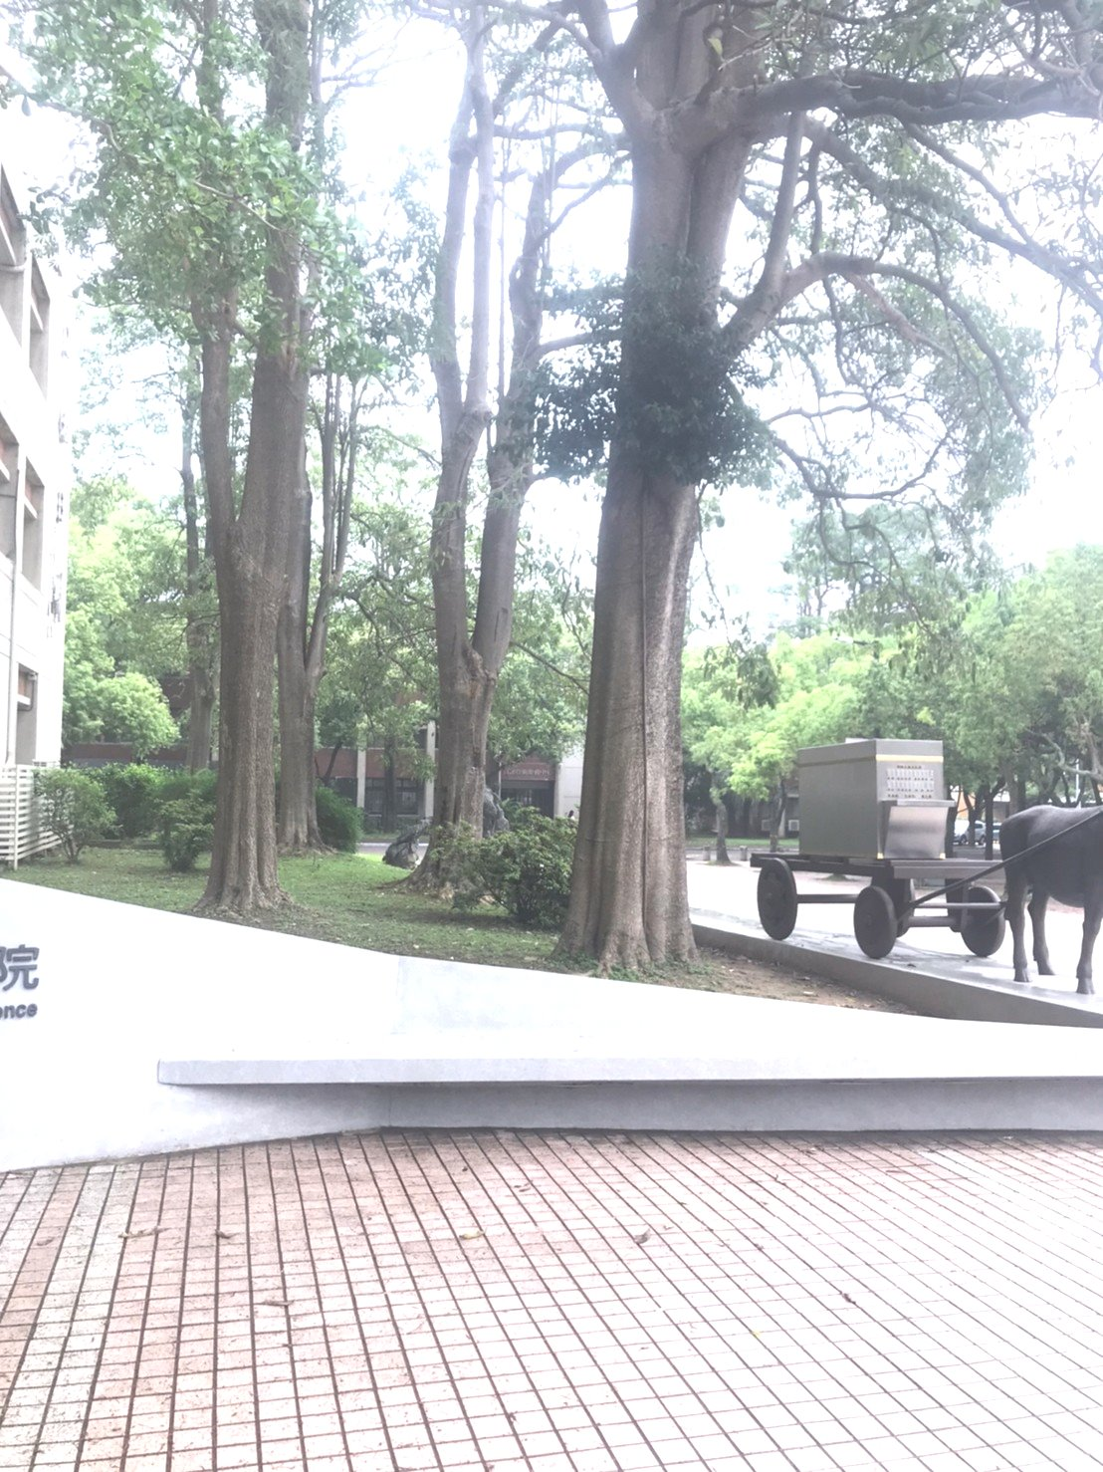
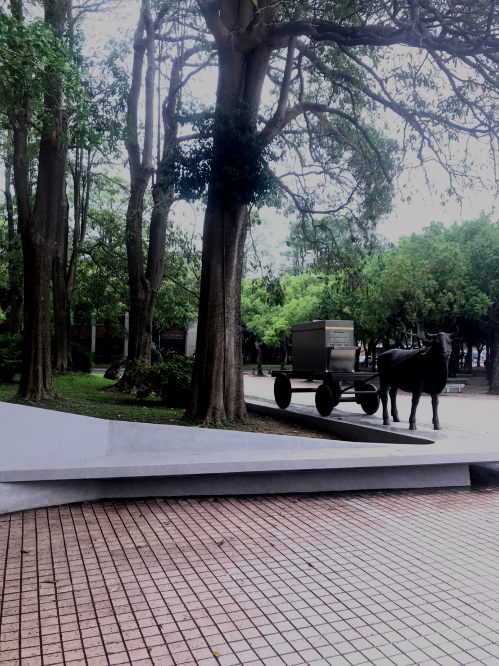
Challenging Task-Gain compensation
Stitching them seamlessly and show how you find your optimizing “g” in the report
?
Notes:
Explain the gamma isn’t same and student must not adjust photos by other methods

